Slide 1

Spring Basic

Slide 2

Introduction

Slide 3
Introduction to Spring

Slide 4
Benefits of using Spring
Spring enables developers to develop enterprise-class applications using POJOs.
Spring is organized in a modular fashion.
Spring does not reinvent the wheel, instead it truly makes use of some of the existing technologies like several ORM frameworks, logging frameworks, JEE, Quartz and JDK timers
Testing an application written with Spring is simple because environment-dependent code is moved into this framework. Furthermore, by using JavaBeanstyle POJOs, it becomes easier to use dependency injection for injecting test data.
Spring provides a convenient API to translate technology-specific exceptions (thrown by JDBC, Hibernate, or JDO, for example) into consistent, unchecked exceptions.
Spring provides a consistent transaction management interface that can scale down to a local transaction (using a single database, for example) and scale up to global transactions using JTA (Java Transaction API), for example.

Slide 5
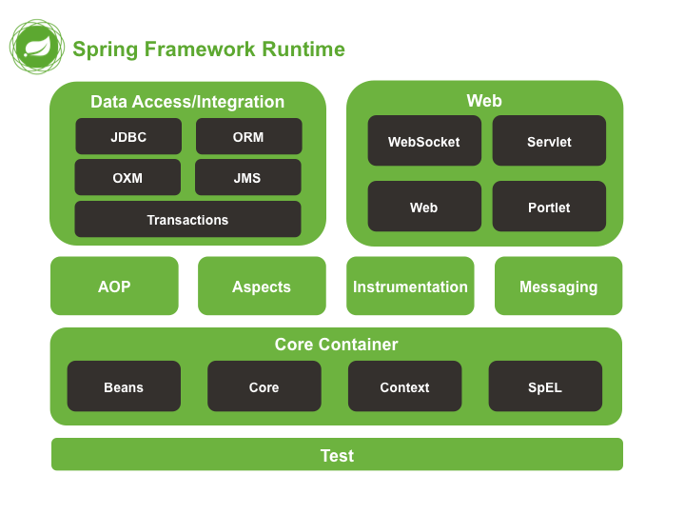
Spring framework architecture and components

Slide 6
Core Container
The Core Container consists of the Core, Beans, Context, and Expression Language.
The Core module provides the fundamental parts of the framework, including the IoC and Dependency Injection features.
The Bean module provides BeanFactory, which is a sophisticated implementation of the factory pattern.
The Context module builds on the solid base provided by the Core and Beans modules and it is a medium to access any objects defined and configured. The ApplicationContext interface is the focal point of the Context module.
The SpEL module provides a powerful expression language for querying and manipulating an object graph at runtime.

Slide 7
Important concepts to understand.
Inversion of Control (IoC)
Dependency Injection (DI)

Slide 8
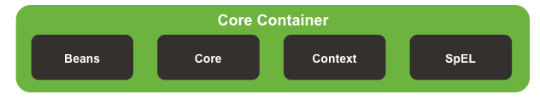
Spring Core Components

Slide 9
What is a Spring Bean

Slide 10
Bean scope
Singleton: @Bean @Scope("singleton"). Singleton is the default value
Prototype: @Bean @Scope("prototype")
Request: @Bean @Scope(value = WebApplicationContext.SCOPE_REQUEST)
Session: @Bean @Scope(value = WebApplicationContext.SCOPE_SESSION)
Application: @Scope( value = WebApplicationContext.SCOPE_APPLICATION)
Websocket: @Scope( value = WebApplicationContext.WEB_SOCKET)

Slide 11
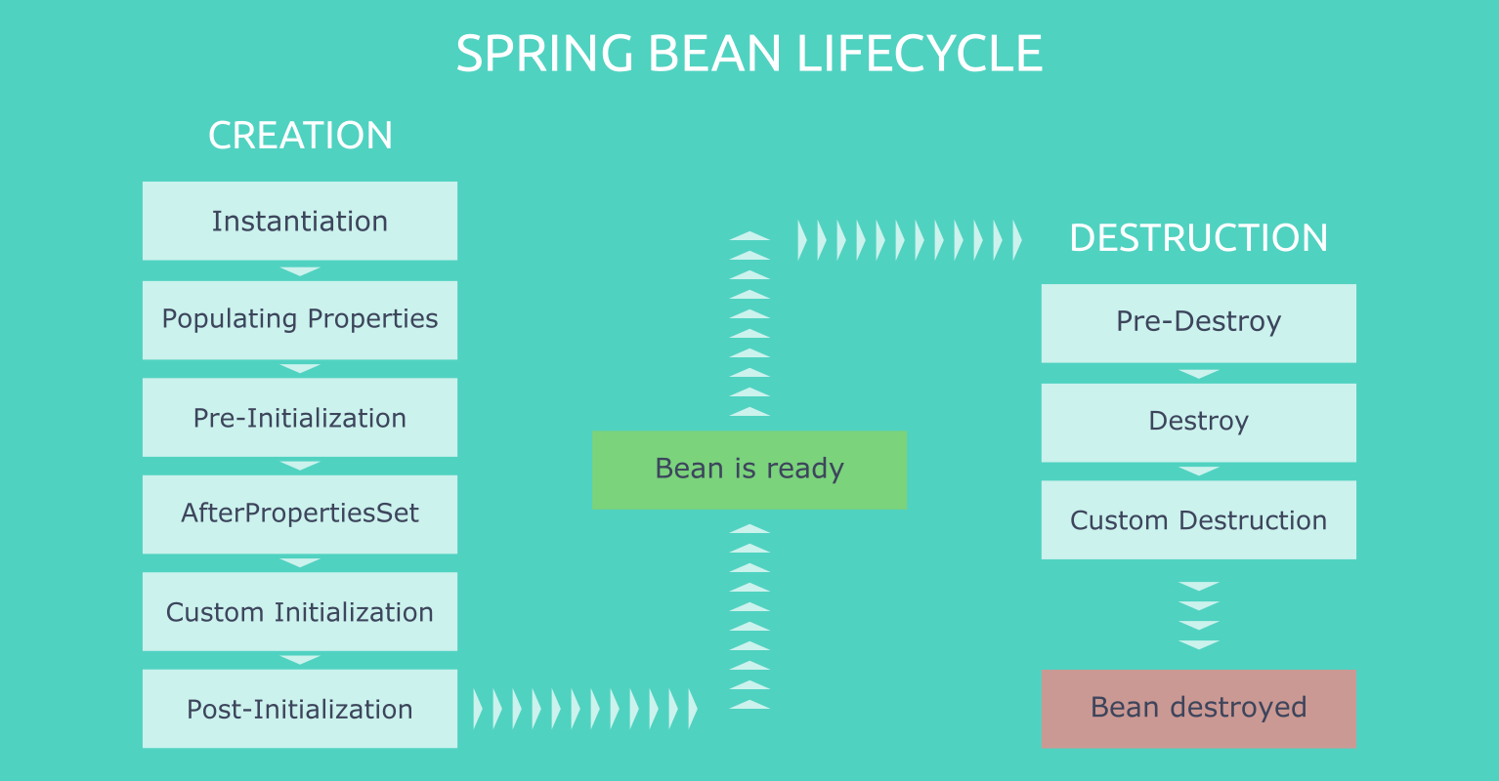
Lifecycle inside the Spring Context

Slide 12
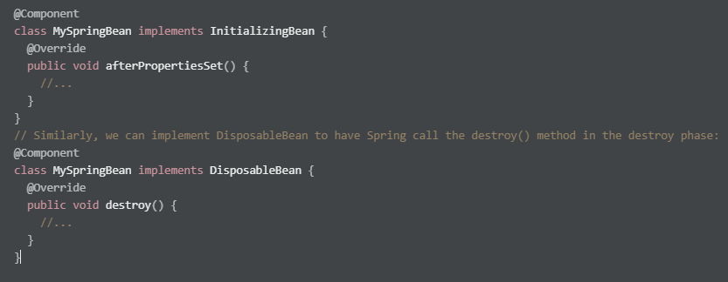
Hooking Into the Bean Lifecycle - Using Spring’s Interfaces

Slide 13
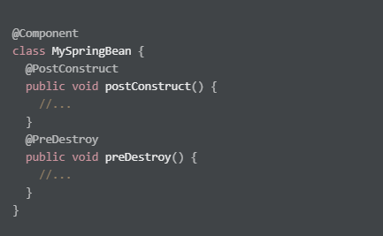
Hooking Into the Bean Lifecycle - Using Annotations

Slide 14
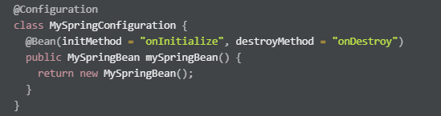
Hooking Into the Bean Lifecycle - Using Attributes of the @Bean Annotation

Slide 15
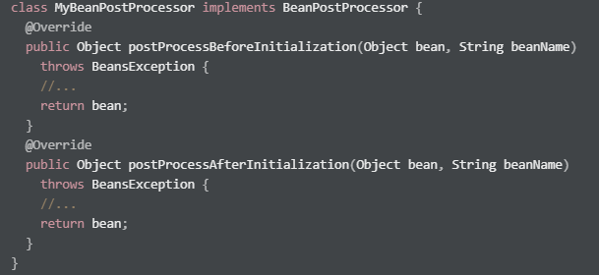
Hooking Into the Bean Lifecycle - Using BeanPostProcessor

Slide 16
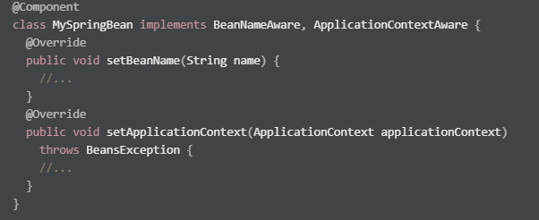
Hooking Into the Bean Lifecycle - Using Aware Interface

Slide 17
Why Would I Need to Hook Into the Bean Lifecycle?
When we need to extend our software with new requirements, it is critical to find the best practices to keep our codebase maintainable in the long run.
Acquiring Bean Properties
Dynamically Changing Spring Bean Instances
Accessing Beans From the Outside of the Spring Context

Slide 18
Autowiring
Starting with Spring 2.5, the framework introduced annotations-driven Dependency Injection. The main annotation of this feature is @Autowired. It allows Spring to resolve and inject collaborating beans into our bean.
The Spring framework enables automatic dependency injection. In other words, by declaring all the bean dependencies in a Spring configuration file, Spring container can autowire relationships between collaborating beans. This is called Spring bean autowiring.

Slide 19
Autowiring Modes
Spring supports the following autowiring modes:
no: It’s the default autowiring mode. It means no autowiring.
byName: The byName mode injects the object dependency according to name of the bean. In such a case, the property and bean name should be the same. It internally calls the setter method.
byType: The byType mode injects the object dependency according to type. So it can have a different property and bean name. It internally calls the setter method.
constructor: The constructor mode injects the dependency by calling the constructor of the class. It calls the constructor having a large number of parameters.
autodetect: In this mode, Spring first tries to autowire by the constructor. If this fails, it tries to autowire by using byType.

Slide 20
Configuration & Profiles
There are 2 ways to declare configuration in Spring:
In Java using the @Configuration annotation
XML. Writing the configuration inside a beans.xml file
Profile:
We can control what part of our code we want to execute using the @Profile annotation
We can declare a profile using -Dspring.profiles.active=dev or declare it in out application.properties
If no profile is declared the ‘default‘ profile is active

Slide 21
DEMO

Slide 22
Spring Context Event Publishing
There are a few simple guidelines to follow:
the event should extend ApplicationEvent
the publisher should inject an ApplicationEventPublisher object
the listener should implement the ApplicationListener interface

Slide 23
Annotation-Driven Event Listener
Starting with Spring 4.2, an event listener is not required to be a bean implementing the ApplicationListener interface – it can be registered on any public method of a managed bean via the @EventListener.
ContextRefreshedEvent
ContextStartedEvent
ContextStoppedEvent
ContextClosedEvent
@EventListener(classes = { ContextStartedEvent.class, ContextStoppedEvent.class })
public void handleMultipleEvents() {
System.out.println("Multi-event listener invoked");
}

Slide 24
Annotation-Driven Event Listener - Transaction Bound Events
Since Spring 4.2, the framework provides a new @TransactionalEventListener annotation, which is an extension of @EventListener, that allows binding the listener of an event to a phase of the transaction. Binding is possible to the following transaction phases:
AFTER_COMMIT (default) is used to fire the event if the transaction has completed successfully
AFTER_ROLLBACK – if the transaction has rolled back
AFTER_COMPLETION – if the transaction has completed (an alias for AFTER_COMMIT and AFTER_ROLLBACK)
BEFORE_COMMIT is used to fire the event right before transaction commit

Slide 25
@TransactionalEventListener(phase = TransactionPhase.BEFORE_COMMIT)
public void handleCustom(CustomSpringEvent event) {
System.out.println("Handling event inside a transaction BEFORE COMMIT.");
}

Slide 26
Spring Expression Language
The Spring Expression Language (SpEL) is a powerful expression language that supports querying and manipulating an object graph at runtime. It can be used with XML or annotation-based Spring configurations.
TYPE | OPERATORS
Arithmetic | +, -, *, /, %, ^, div, mod
Relational | <, >, ==, !=, <=, >=, lt, gt, eq, ne, le, ge
Logical | and, or, not, &&, ||, !
Conditional | ?:
Regex | Regex

Slide 27
DEMO

Slide 28
Spring AOP
Aspect-oriented Programming (AOP) complements Object-oriented Programming (OOP) by providing another way of thinking about program structure. The key unit of modularity in OOP is the class, whereas in AOP the unit of modularity is the aspect. Aspects enable the modularization of concerns (such as transaction management) that cut across multiple types and objects. (Such concerns are often termed “crosscutting” concerns in AOP literature.)

Slide 29
AOP Concepts
Aspect: A modularization of a concern that cuts across multiple classes.
Join point: A point during the execution of a program, such as the execution of a method or the handling of an exception.
Advice: Action taken by an aspect at a particular join point.
Pointcut: A predicate that matches join points.
Introduction: Declaring additional methods or fields on behalf of a type.
Target object: An object being advised by one or more aspects.
AOP proxy: An object created by the AOP framework in order to implement the aspect contracts (advise method executions and so on).
Weaving: linking aspects with other application types or objects to create an advised object. This can be done at compile time (using the AspectJ compiler, for example), load time, or at runtime. Spring AOP, like other pure Java AOP frameworks, performs weaving at runtime.

Slide 30
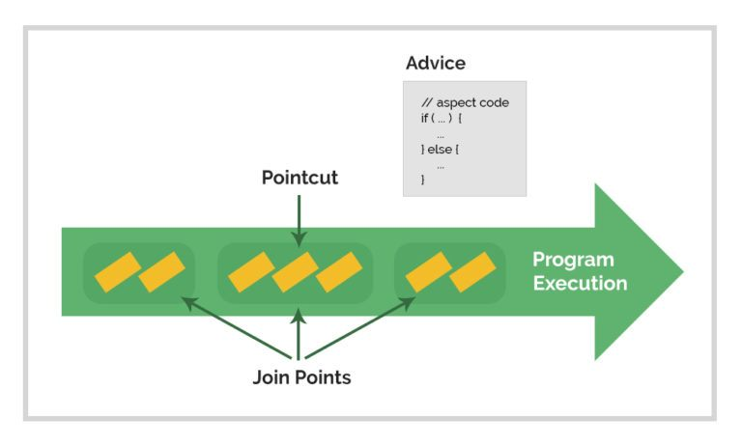

Slide 31
DEMO

Slide 32
Spring Boot

Slide 33
Spring Boot
Advantages
Spring Boot offers the following advantages:
Easy to understand and develop spring applications
Increases productivity
Reduces the development time
Goals
Spring Boot is designed with the following goals −
To avoid complex XML configuration in Spring
To develop a production ready Spring applications in an easier way
To reduce the development time and run the application independently
Offer an easier way of getting started with the application

Slide 34
Spring Boot
How does it work?
Spring Boot automatically configures your application based on the dependencies you have added to the project by using @EnableAutoConfiguration annotation. For example, if MySQL database is on your classpath, but you have not configured any database connection, then Spring Boot auto-configures an in-memory database.
The entry point of the spring boot application is the class contains @SpringBootApplication annotation and the main method.
Spring Boot automatically scans all the components included in the project by using @ComponentScan annotation.

Slide 35
Spring Boot Starters
Handling dependency management is a difficult task for big projects. Spring Boot resolves this problem by providing a set of dependencies for developers convenience.
For example, if you want to use Spring and JPA for database access, it is sufficient if you include spring-boot-starter-data-jpa dependency in your project.
Note that all Spring Boot starters follow the same naming pattern spring-boot-starter- *, where * indicates that it is a type of the application.

Slide 36
Spring Boot Application
The entry point of the Spring Boot Application is the class contains @SpringBootApplication annotation.
This class should have the main method to run the Spring Boot application.
@SpringBootApplication annotation includes Auto- Configuration, Component Scan, and Spring Boot Configuration.

Slide 37
Concepts of auto-config
Spring Boot Auto Configuration automatically configures your Spring application based on the JAR dependencies you added in the project.
For this purpose, you need to add @EnableAutoConfiguration annotation or @SpringBootApplication annotation to your main class file. Then, your Spring Boot application will be automatically configured.
Spring configuration classes are marked with @Configuration.

Slide 38
Component Scan
Spring Boot application scans all the beans and package declarations when the application initializes. You need to add the @ComponentScan annotation for your class file to scan your components added in your project.

Slide 39
Build Tool - Maven
Maven has enhanced dependency management.
In Maven, there is no need to store the binary libraries (third party) within the source control.
It efficiently manages the hierarchical dependency tree.
It makes the debugging process more straightforward.
It provides better co-operation among the source code, plugin, libraries, and the IDE.
It reduces the duplication within the project.

Slide 40
Build Tool - Gradle
Gradle allows us to write the build script with Java programing language.
It is easy to use and maintain.
It supports dependency management
It provides high performance and scalable builds.
Gradle integration process is quite easier.
It supports a multi-project structure.
It is easy to migrate to Gradle from Maven or other build tools.

Slide 41
Build tools
Gradle | Maven
It is a build automation system that uses a Groovy-based DSL (domain-specific language ) | It is a software project management system that is primarily used for java projects.
It does not use an XML file for declaring the project configuration. | It uses an XML file for declaring the project, its dependencies, the build order, and its required plugin.
It is based on a graph of task dependencies that do the work. | It is based on the phases of the fixed and linear model.
In Gradle, the main goal is to add functionality to the project. | In maven, the main goal is related to the project phase.
It avoids the work by tracking input and output tasks and only runs the tasks that have been changed. Therefore it gives a faster performance. | It does not use the build cache; thus, its build time is slower than Gradle.
Gradle is highly customizable; it provides a wide range of IDE support custom builds. | Maven has a limited number of parameters and requirements, so customization is a bit complicated.

Slide 42
Demo Spring Initializer

Slide 43
Building Web Applications

Slide 44
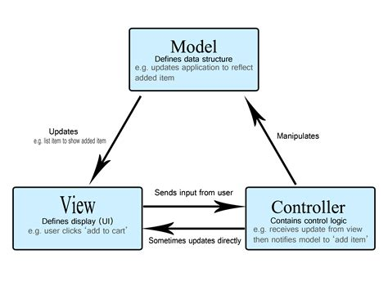
MVC Pattern

Slide 45
MVC - Pattern
Model–view–controller (usually known as MVC) is a software design pattern commonly used for developing user interfaces that divides the related program logic into three interconnected elements. This is done to separate internal representations of information from the ways information is presented to and accepted from the user. This kind of pattern is used for designing the layout of the page.
Traditionally used for desktop graphical user interfaces (GUIs), this pattern has become popular for designing web applications. Popular programming languages like JavaScript, Python, Ruby, PHP, Java, C#, and Swift have MVC frameworks that are used for web or mobile application development straight out of the box.
Model The central component of the pattern. It is the application's dynamic data structure, independent of the user interface. It directly manages the data, logic and rules of the application.
View Any representation of information such as a chart, diagram or table. Multiple views of the same information are possible, such as a bar chart for management and a tabular view for accountants.
Controller Accepts input and converts it to commands for the model or view.

Slide 46
Http Protocol and Request Methods
The Hypertext Transfer Protocol (HTTP) is an application layer protocol for distributed, collaborative, hypermedia information systems.[1] HTTP is the foundation of data communication for the World Wide Web, where hypertext documents include hyperlinks to other resources that the user can easily access.
HTTP defines a set of request methods to indicate the desired action to be performed for a given resource. Although they can also be nouns, these request methods are sometimes referred to as HTTP verbs. Each of them implements a different semantic, but some common features are shared by a group of them: e.g. a request method can be safe, idempotent, or cacheable.

Slide 47
Request Methods
The GET method requests a representation of the specified resource. Requests using GET should only retrieve data.
The HEAD method asks for a response identical to that of a GET request, but without the response body.
The POST method is used to submit an entity to the specified resource, often causing a change in state or side effects on the server.
The PUT method replaces all current representations of the target resource with the request payload.
The DELETE method deletes the specified resource.
The CONNECT method establishes a tunnel to the server identified by the target resource.
The OPTIONS method is used to describe the communication options for the target resource.
The TRACE method performs a message loop-back test along the path to the target resource.
The PATCH method is used to apply partial modifications to a resource.

Slide 48
Thymeleaf
Thymeleaf is a modern server-side Java template engine for both web and standalone environments.
Thymeleaf's main goal is to bring elegant natural templates to your development workflow — HTML that can be correctly displayed in browsers and also work as static prototypes, allowing for stronger collaboration in development teams.
Most Thymeleaf attributes allow their values to be set as or containing expressions, which we will call Standard Expressions because of the dialects they are used in. These can be of five types:
${...} : Variable expressions.
*{...} : Selection expressions.
#{...} : Message (i18n) expressions.
@{...} : Link (URL) expressions.
~{...} : Fragment expressions.

Slide 49
Internationalization and Location
Imagine that you have brought a nice imported TV from Japan that is equipped with a wonderful set of features. You have opened the box and found an instruction manual that is written in the Japanese. Will you be comfortable in operating the TV with the given set of instructions?
Same is the case with any software application. Consider, you want to cater your online retail website to the people across the world and you have not presented the website interface to the user in their local language. This definitely hampers the user experience and in-turn has a lot of impact on your global market revenue.
This is where Internationalization (i18n) comes into picture.
Internationalization is the process of ensuring that your website accommodates multiple languages and cultural conventions to make the creation of localized sites possible.
Spring Boot provides a lot of built in features to support Internationalization through ResourceBundles, LocaleResolvers and Interceptors.

Slide 50
Message (i18n) expressions
Message expressions (often called text externalization, internationalization or i18n) allows us to retrieve locale-specific messages from external sources (.properties files), referencing them by a key and (optionally) applying a set of parameters.
In Spring applications, this will automatically integrate with Spring’s MessageSource mechanism.
<table>
...
<th th:text="#{header.address.city}">...</th>
<th th:text="#{header.address.country}">...</th>
...
</table>

Slide 51
Validation in Spring Boot
Starting with Boot 2.3, we also need to explicitly add the spring-boot-starter-validation dependency:
<dependency>
<groupId>org.springframework.boot</groupId>
<artifactId>spring-boot-starter-validation</artifactId>
</dependency>
Few of the validation annotations are:
@NotNull: Ensures that the input field is not null.
@NotEmpty: Ensures that the field is not empty. It can be applied to fields of type String, collections, etc.
@Min: The entered number should be equal to or greater than the defined minimum value.
@Max: The entered number should be equal to or less than the defined maximum value.
@Pattern: This validation annotation can be used to match the input with the specified regex expression. We have used the phone number field to match the specified regex expression in our example.
@Size: To validate the size of the input character sequence, map, list, etc.
@Past: Makes sure that the input date/time is of the past.

Slide 52
Error and Exception handling
Spring MVC provides several complimentary approaches to exception handling.
Our goal is to not handle exceptions explicitly in Controller methods where possible. They are a cross-cutting concern better handled separately in dedicated code.
There are three options:
Per controller
Globally
Per exception

Slide 53
Controller Based Exception Handling
You can add extra (@ExceptionHandler) methods to any controller to specifically handle exceptions thrown by request handling (@RequestMapping) methods in the same controller. Such methods can:
Handle exceptions without the @ResponseStatus annotation (typically predefined exceptions that you didn’t write)
Redirect the user to a dedicated error view
Build a totally custom error response
@ResponseStatus(value=HttpStatus.CONFLICT, reason="Data integrity violation") // 409
@ExceptionHandler(DataIntegrityViolationException.class)
public void conflict() { // Nothing to do }

Slide 54
Global Exception Handling
Using @ControllerAdvice Classes
A controller advice allows you to use exactly the same exception handling techniques but apply them across the whole application, not just to an individual controller. You can think of them as an annotation driven interceptor.
Any class annotated with @ControllerAdvice becomes a controller-advice and three types of method are supported:
Exception handling methods annotated with @ExceptionHandler.
Model enhancement methods (for adding additional data to the model) annotated with@ModelAttribute. Note that these attributes are not available to the exception handling views.
Binder initialization methods (used for configuring form-handling) annotated with@InitBinder.

Slide 55
Per Exception Handle
HandlerExceptionResolver
Any Spring bean declared in the DispatcherServlet’s application context that implements HandlerExceptionResolver will be used to intercept and process any exception raised in the MVC system and not handled by a Controller. The interface looks like this:
public interface HandlerExceptionResolver {
ModelAndView resolveException(HttpServletRequest request,
HttpServletResponse response, Object handler, Exception ex);
}
The handler refers to the controller that generated the exception (remember that @Controller instances are only one type of handler supported by Spring MVC. For example: HttpInvokerExporter and the WebFlow Executor are also types of handler).

Slide 56
What to Use When?
As usual, Spring likes to offer you choice, so what should you do? Here are some rules of thumb. However if you have a preference for XML configuration or Annotations, that’s fine too.
For exceptions you write, consider adding @ResponseStatus to them.
For all other exceptions implement an @ExceptionHandler method on a @ControllerAdvice class or use an instance of SimpleMappingExceptionResolver. You may well have SimpleMappingExceptionResolver configured for your application already, in which case it may be easier to add new exception classes to it than implement a @ControllerAdvice.
For Controller specific exception handling add @ExceptionHandler methods to your controller.
Warning: Be careful mixing too many of these options in the same application. If the same exception can be handed in more than one way, you may not get the behavior you wanted. @ExceptionHandler methods on the Controller are always selected before those on any @ControllerAdvice instance. It is what order controller-advices are processed.

Slide 57
DEMO

Slide 58
Persistence layer using Spring JDBC and Spring Data
In computer science, persistence refers to the characteristic of state that outlives the process that created it. This is achieved in practice by storing the state as data in computer data storage. Programs have to transfer data to and from storage devices and have to provide mappings from the native programming-language data structures to the storage device data structures.

Slide 59
JDBC
JDBC (Java Database Connectivity) is the Java API that manages connecting to a database, issuing queries and commands, and handling result sets obtained from the database. Released as part of JDK 1.1 in 1997, JDBC was one of the first components developed for the Java persistence layer.
JDBC was initially conceived as a client-side API, enabling a Java client to interact with a data source. That changed with JDCB 2.0, which included an optional package supporting server-side JDBC connections. Every new JDBC release since then has featured updates to both the client-side package (java.sql) and the server-side package (javax.sql). JDBC 4.3, the most current version as of this writing, was released as part of Java SE 9 in September 2017.

Slide 60
JDBC Interaction
Steps:
Install or locate the database you want to access.
Include the JDBC library.
Ensure the JDBC driver you need is on your classpath.
Use the JDBC library to obtain a connection to the database.
Use the connection to issue SQL commands.
Close the connection when you're finished.

Slide 61
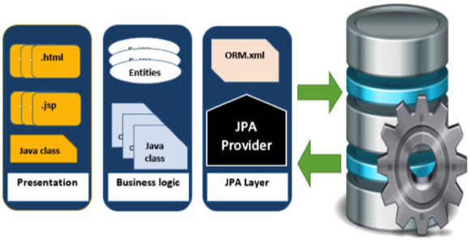
JPA and ORM frameworks
Java Persistence API is a collection of classes and methods to persistently store the vast amounts of data into a database which is provided by the Oracle Corporation.
To reduce the burden of writing codes for relational object management, a programmer follows the ‘JPA Provider’ framework, which allows easy interaction with database instance. Here the required framework is taken over by JPA.

Slide 62
JPA History
Earlier versions of EJB, defined persistence layer combined with business logic layer using javax.ejb.EntityBean Interface.
While introducing EJB 3.0, the persistence layer was separated and specified as JPA 1.0 (Java Persistence API). The specifications of this API were released along with the specifications of JAVA EE5 on May 11, 2006 using JSR 220.
JPA 2.0 was released with the specifications of JAVA EE6 on December 10, 2009 as a part of Java Community Process JSR 317.
JPA 2.1 was released with the specification of JAVA EE7 on April 22, 2013 using JSR 338.
JPA is an open source API, therefore various enterprise vendors such as Oracle, Redhat, Eclipse, etc. provide new products by adding the JPA persistence flavor in them. Some of these products include:
Hibernate, Eclipselink, Toplink, Spring Data JPA.

Slide 63
Object-relational mapping
In computer science is a programming technique for converting data between incompatible type systems using object-oriented programming languages. This creates, in effect, a "virtual object database" that can be used from within the programming language. There are both free and commercial packages available that perform object-relational mapping, although some programmers opt to construct their own ORM tools.
Hibernate ORM enables developers to more easily write applications whose data outlives the application process. As an Object/Relational Mapping (ORM) framework, Hibernate is concerned with data persistence as it applies to relational databases (via JDBC). Unfamiliar with the notion of ORM?

Slide 64
Hibernate
Idiomatic persistence Hibernate enables you to develop persistent classes following natural Object-oriented idioms including inheritance, polymorphism, association, composition, and the Java collections framework. Hibernate requires no interfaces or base classes for persistent classes and enables any class or data structure to be persistent.
High Performance Hibernate supports lazy initialization, numerous fetching strategies and optimistic locking with automatic versioning and time stamping. Hibernate requires no special database tables or fields and generates much of the SQL at system initialization time instead of at runtime.
Hibernate consistently offers superior performance over straight JDBC code, both in terms of developer productivity and runtime performance.
Scalability Hibernate was designed to work in an application server cluster and deliver a highly scalable architecture. Hibernate scales well in any environment: Use it to drive your in-house Intranet that serves hundreds of users or for mission-critical applications that serve hundreds of thousands.
Reliable Hibernate is well known for its excellent stability and quality, proven by the acceptance and use by tens of thousands of Java developers.

Slide 65
DEMO

Slide 66
Best practices when creating a RESTful API
REST APIs are one of the most common kinds of web services available today. They allow various clients including browser apps to communicate with a server via the REST API.
Therefore, it’s very important to design REST APIs properly so that we won’t run into problems down the road. We have to take into account security, performance, and ease of use for API consumers.
Otherwise, we create problems for clients that use our APIs, which isn’t pleasant and detracts people from using our API. If we don’t follow commonly accepted conventions, then we confuse the maintainers of the API and the clients that use them since it’s different from what everyone expects.

Slide 67
Accept and respond with JSON
REST APIs should accept JSON for request payload and also send responses to JSON. JSON is the standard for transferring data. Almost every networked technology can use it: JavaScript has built-in methods to encode and decode JSON either through the Fetch API or another HTTP client. Server-side technologies have libraries that can decode JSON without doing much work.
There are other ways to transfer data. XML isn’t widely supported by frameworks without transforming the data ourselves to something that can be used, and that’s usually JSON. We can’t manipulate this data as easily on the client-side, especially in browsers. It ends up being a lot of extra work just to do normal data transfer.
Form data is good for sending data, especially if we want to send files. But for text and numbers, we don’t need form data to transfer those since—with most frameworks—we can transfer JSON by just getting the data from it directly on the client side. It’s by far the most straightforward to do so.

Slide 68
Use nouns instead of verbs in endpoint paths
We shouldn’t use verbs in our endpoint paths. Instead, we should use the nouns which represent the entity that the endpoint that we’re retrieving or manipulating as the pathname.
This is because our HTTP request method already has the verb. Having verbs in our API endpoint paths isn’t useful and it makes it unnecessarily long since it doesn’t convey any new information. The chosen verbs could vary by the developer’s whim. For instance, some like ‘get’ and some like ‘retrieve’, so it’s just better to let the HTTP GET verb tell us what and endpoint does.
With the two principles we discussed above in mind, we should create routes like GET /articles/ for getting news articles. Likewise, POST /articles/ is for adding a new article , PUT /articles/:id is for updating the article with the given id. DELETE /articles/:id is for deleting an existing article with the given ID.

Slide 69
Name collections with plural nouns
We should name collections with plural nouns. It’s not often that we only want to get a single item, so we should be consistent with our naming, we should use plural nouns.
We use plurals to be consistent with what’s in our databases. Tables usually have more than one entry and are named to reflect that, so to be consistent with them, we should use the same language as the table the API accesses.
With the /articles endpoint, we have the plural form for all endpoints, so we don’t have to change it to be plural.

Slide 70
Nesting resources for hierarchical objects
The path of the endpoints that deal with nested resources should be done by appending the nested resource as the name of the path that comes after the parent resource.
We have to make sure that it makes sure what we considered a nested resources matches what we have in our database tables. Otherwise, it’ll be confusing.
For instance, if we want an endpoint to get the comments for a news article, we should append the /comments path to the end of the /articles path. This is assuming that we have comments as a child of an article in our database.

Slide 71
Handle errors gracefully and return standard error codes
To eliminate confusion for API users when an error occurs, we should handle errors gracefully and return HTTP response codes that indicate what kind of error occurred. This gives maintainers of the API enough information to understand the problem that’s occurred. We don’t want errors to bring down our system, so we can leave them unhandled, which means that the API consumer has to handle them.
Common error HTTP status codes include:
400 Bad Request – This means that client-side input fails validation.
401 Unauthorized – This means the user isn’t not authorized to access a resource. It usually returns when the user isn’t authenticated.
403 Forbidden – This means the user is authenticated, but it’s not allowed to access a resource.
404 Not Found – This indicates that a resource is not found.
500 Internal server error – This is a generic server error. It probably shouldn’t be thrown explicitly.
502 Bad Gateway – This indicates an invalid response from an upstream server.
503 Service Unavailable – This indicates that something unexpected happened on server side (It can be anything like server overload, some parts of the system failed, etc.).

Slide 72
Allow filtering, sorting, and pagination
The databases behind a REST API can get very large. Sometimes, there’s so much data that it shouldn’t be returned all at once because it’s way too slow or will bring down our systems. Therefore, we need ways to filter items.
We also need ways to paginate data so that we only return a few results at a time. We don’t want to tie up resources for too long by trying to get all the requested data at once.
Filtering and pagination both increase performance by reducing the usage of server resources. As more data accumulates in the database, the more important these features become.

Slide 73
Maintain Good Security Practices
Most communication between client and server should be private since we often send and receive private information. Therefore, using SSL/TLS for security is a must.
A SSL certificate isn’t too difficult to load onto a server and the cost is free or very low. There’s no reason not to make our REST APIs communicate over secure channels instead of in the open.
People shouldn’t be able to access more information that they requested. For example, a normal user shouldn’t be able to access information of another user. They also shouldn’t be able to access data of admins.
To enforce the principle of least privilege, we need to add role checks either for a single role, or have more granular roles for each user.

Slide 74
Spring Data Rest
Spring Data REST is part of the umbrella Spring Data project and makes it easy to build hypermedia-driven REST web services on top of Spring Data repositories.
Spring Data REST builds on top of Spring Data repositories, analyzes your application’s domain model and exposes hypermedia-driven HTTP resources for aggregates contained in the model.

Slide 75
Features
Exposes a discoverable REST API for your domain model using HAL as media type.
Exposes collection, item and association resources representing your model.
Supports pagination via navigational links.
Allows to dynamically filter collection resources.
Exposes dedicated search resources for query methods defined in your repositories.
Allows to hook into the handling of REST requests by handling Spring ApplicationEvents.
Exposes metadata about the model discovered as ALPS and JSON Schema.
Allows to define client specific representations through projections.
Ships a customized variant of the HAL Browser to leverage the exposed metadata.
Currently supports JPA, MongoDB, Neo4j, Solr, Cassandra, Gemfire.
Allows advanced customizations of the default resources exposed.

Slide 76
Hypermedia links and a HAL browser (explorer)
JSON Hypertext Application Language, or HAL, is a simple format that gives a consistent and easy way to hyperlink between resources in our API. Including HAL within our REST API makes it much more explorable to users as well as being essentially self-documenting.
The HAL model revolves around two simple concepts.
Resources, which contain:
Links to relevant URIs
Embedded Resources
State
Links:
A target URI
A relation, or rel, to the link
A few other optional properties to help with depreciation, content negotiation, etc
The HAL browser was created by the same person who developed HAL and provides an in-browser GUI to traverse your REST API.

Slide 77
Swagger
Swagger is a specification for documenting REST API. It specifies the format (URL, method, and representation) to describe REST web services. The goal is to enable the service producer to update the service documentation in real time so that client (consumer) can get up-to-date information about the service structure (request/response, model, etc). With swagger, documentation systems are moving at the same pace as the server because all methods, parameters, and models description are tightly integrated into the server code, thereby maintaining the synchronization in APIs and its documentation.
Swagger is very helpful for automating the documentation of your APIs, and I always using it for every Spring API Projects. For this article, you'll need a Spring Boot application with Rest Controller(s).

Slide 78
Spring OpenAPI
As any other specification would, OpenAPI lays out certain ground rules for its implementations to follow. Simply put, all OpenAPI implementations are supposed to produce the documentation as a JSON object, either in JSON or YAML format.
There also exist many tools that take this JSON/YAML in and spit out a UI to visualize and navigate the API. This comes in handy during acceptance testing, for example. In our code samples here, we'll be using springdoc – a library for OpenAPI 3 with Spring Boot.
Important: Spring OpenAPI doesn't work with @Controller

Slide 79
DEMO

Slide 80
Spring Test Framework
Testing Spring controllers can be interesting to test. Before MockMVC existed, the options were limited to:
Instantiating a copy of the controller class, injected the dependencies (possibly with mocks) and calling the methods by hand.
Firing up the container and making HTTP calls by hand
Using something like selenium to automated the HTTP calls.

Slide 81
Components
SpringRunner s an alias for the SpringJUnit4ClassRunner. It is a custom extension of JUnit’s BlockJUnit4ClassRunner which provides functionality of the Spring TestContext Framework to standard JUnit tests by means of the TestContextManager and associated support classes and annotations.
@WebMvcTes annotation is used for Spring MVC tests. It disables full auto-configuration and instead apply only configuration relevant to MVC tests.
The WebMvcTest annotation auto-configure MockMvc instance as well.
Using RestController.class as parameter, we are asking to initialize only one web controller and you need to provide remaining dependencies required using Mock objects.

Slide 82
DEMO

Slide 83
Spring Annotations
@SpringBootApplication (Spring Boot)
@Required
@Autowired
@Configuration
@ComponentScan
@Bean
@Component
@Service
@Repository

Slide 84
Controller Annotations
@GetMapping
@PostMapping
@PutMapping
@DeleteMapping
@PatchMapping
@RequestBody
@ResponseBody
@PathVariable
@RequestParam
@RequestHeader
@RestController
@RequestAttribute

